Slide 1


Education Spending & Economic Growth
A Global Relationship Analysis
World Bank Data • R • Regression & ML
Made By:
Faisal Jaber Naem (221983)
Taha Mahmoud Abo Al-Hija (231643)
Supervised By:
Prof. Eslam Al-Hersh

Slide 2
Part 1.1: Motivation
Why this matters:
Education is considered a key driver of development
Governments invest very different shares of GDP in education
Economic growth varies widely across countries and time

Slide 3
Part 1.2: Research Goal
Goal of the Project:
Assess the strength of the relationship
Between education spending and GDP growth
Not to predict GDP

Slide 4
Part 2.1: Data Source & Scope
Data:
World Bank – World Development Indicators
Global, multi-country panel data
Unit of analysis: Country–Year
Time Structure:
Multiple years per country
Allows cross-country and temporal comparison

Slide 5
Part 2.2: Variables Used
Key Variables:
Education Spending (% of GDP)
GDP Growth (%)
Control Variables:
Unemployment (%)
Inflation (%)
Population Growth (%)
Why controls?:
GDP growth is influenced by many macroeconomic conditions

Slide 6
Part 2.3: Data Preparation & Outputs
What we did:
Selected only relevant indicators
Reshaped data into country–year format
Converted all variables to numeric
Removed incomplete observations
Reproducibility:
Clean dataset saved as CSV
Model outputs and predictions saved as CSV files

Slide 7
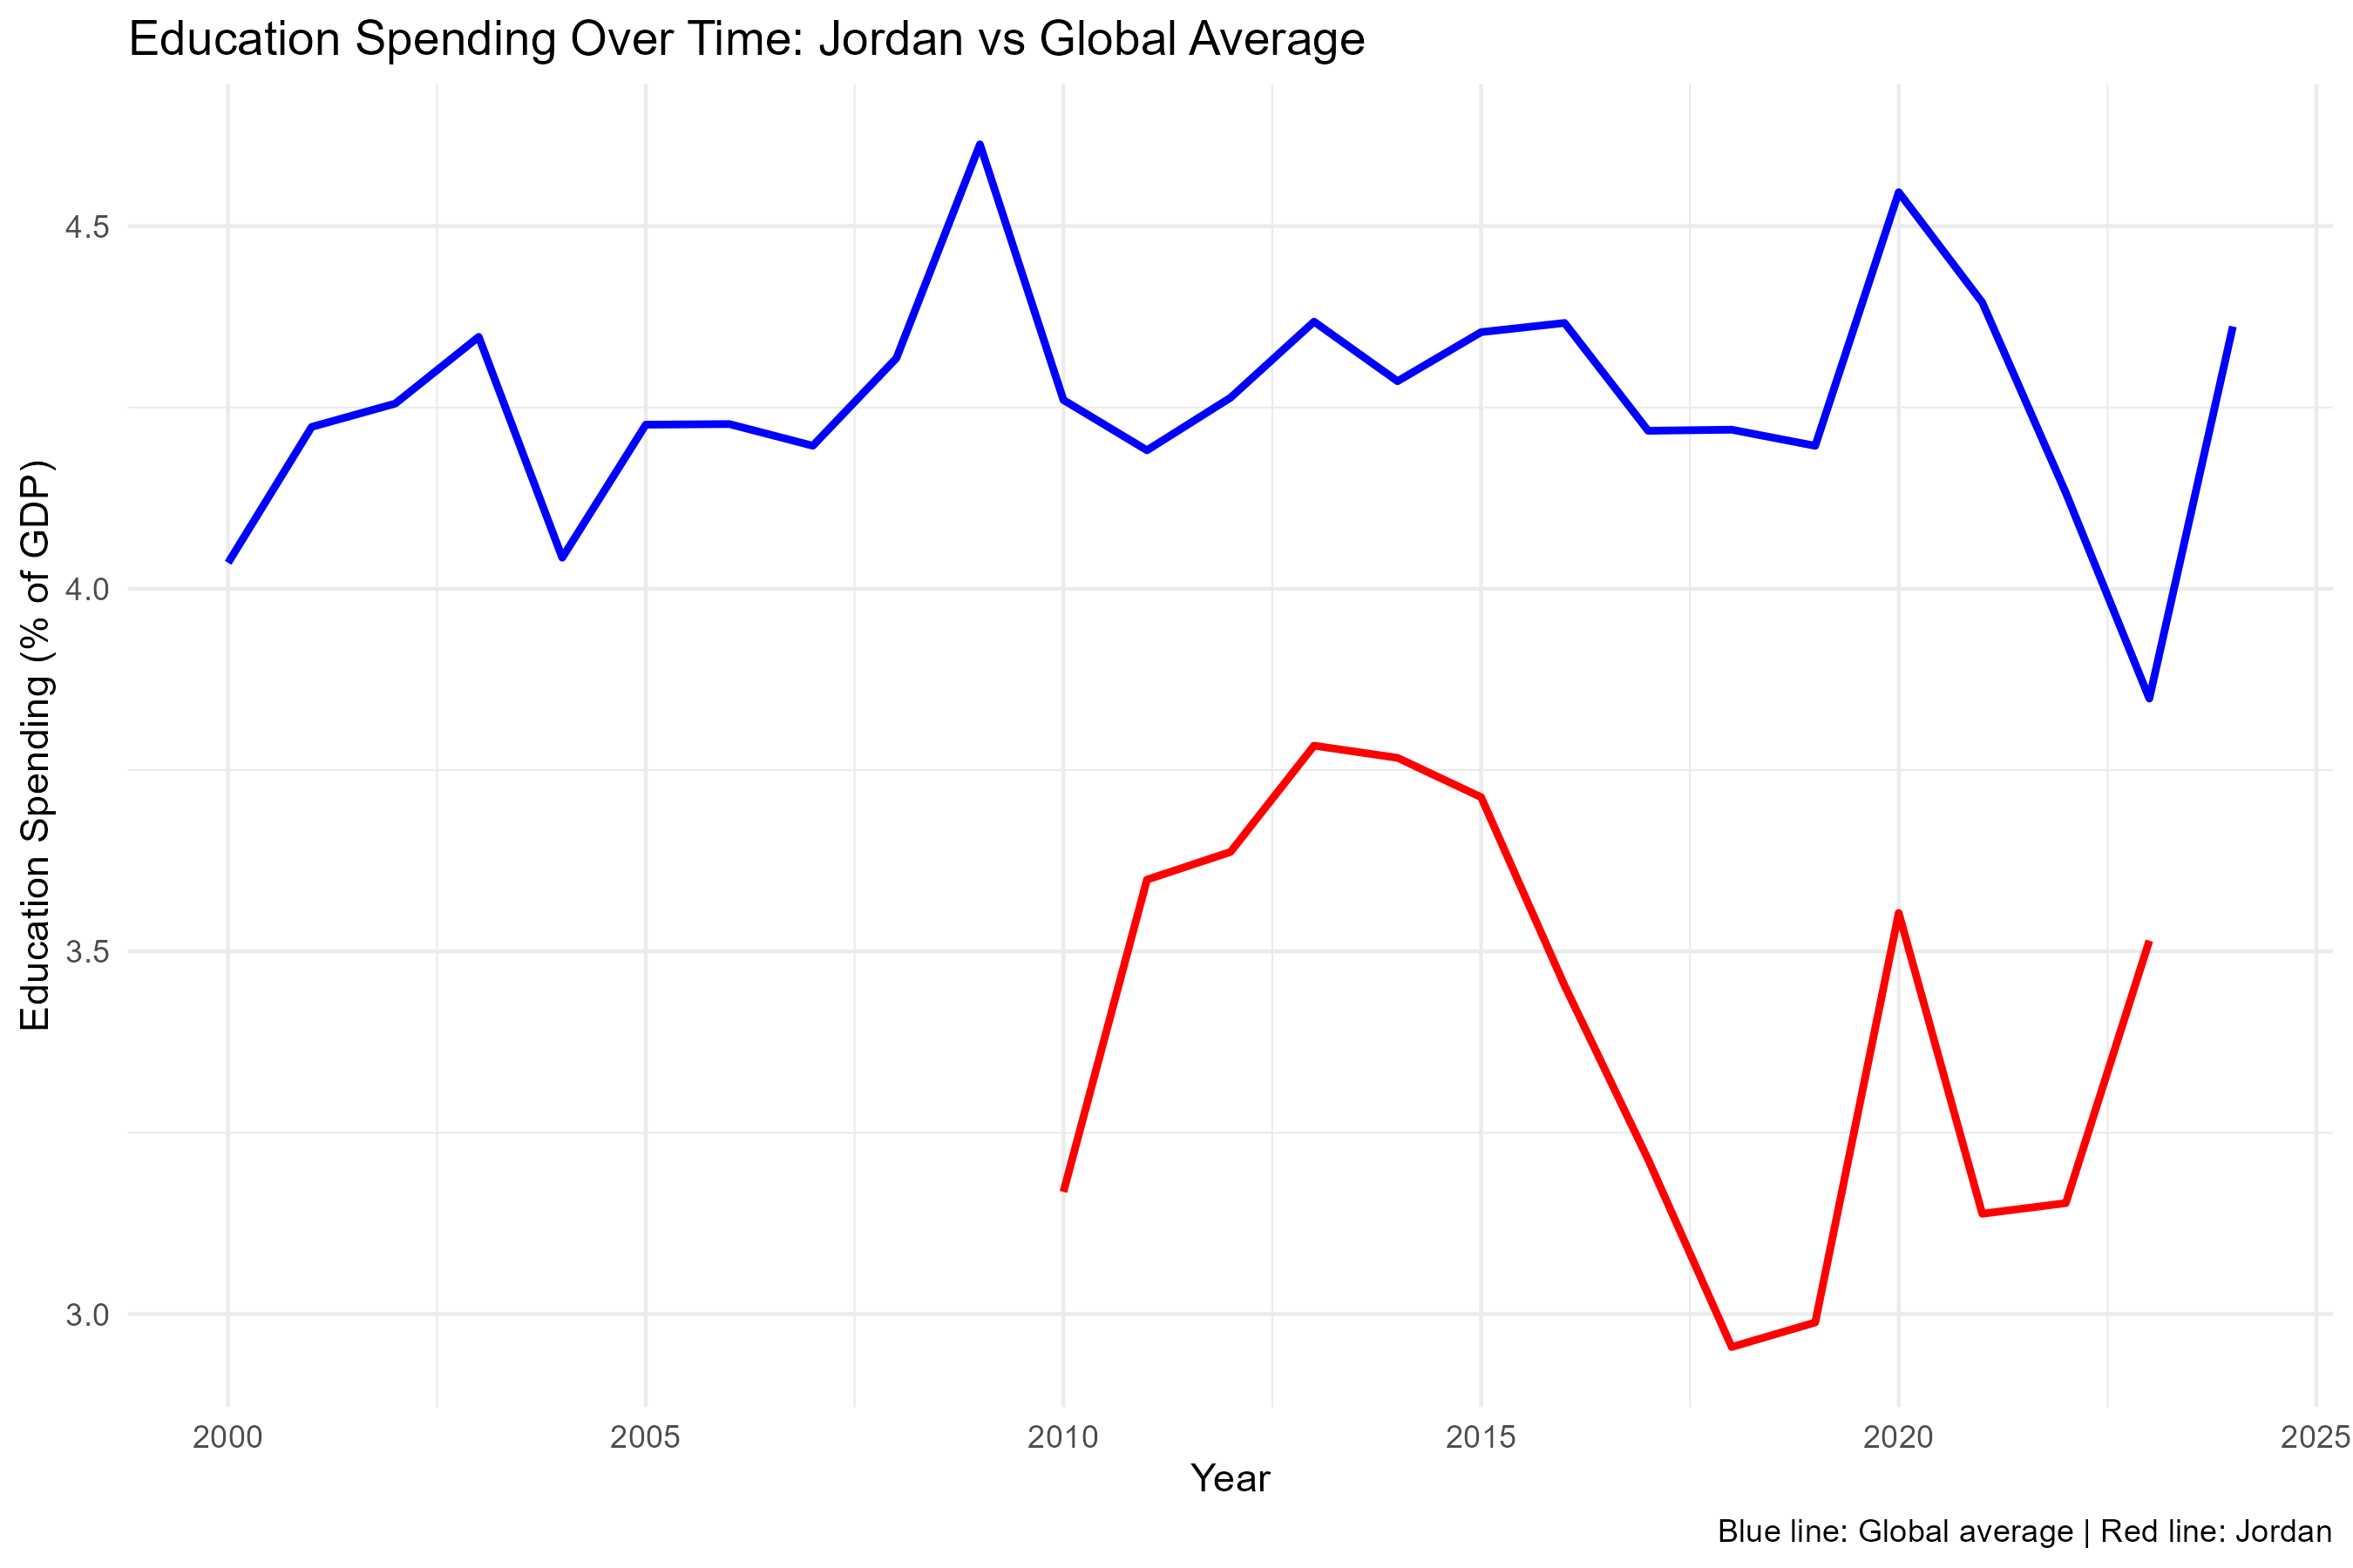
Part 3.1: Exploratory Analysis: Context

Slide 8
Part 3.1: Exploratory Analysis: Context
What the plot shows:
Global average education spending is relatively stable
Jordan’s spending is:
  Lower than the global average
  More volatile over time
Why this plot exists:
Provides context
Highlights cross-country differences
Motivates a global rather than country-specific analysis

Slide 9
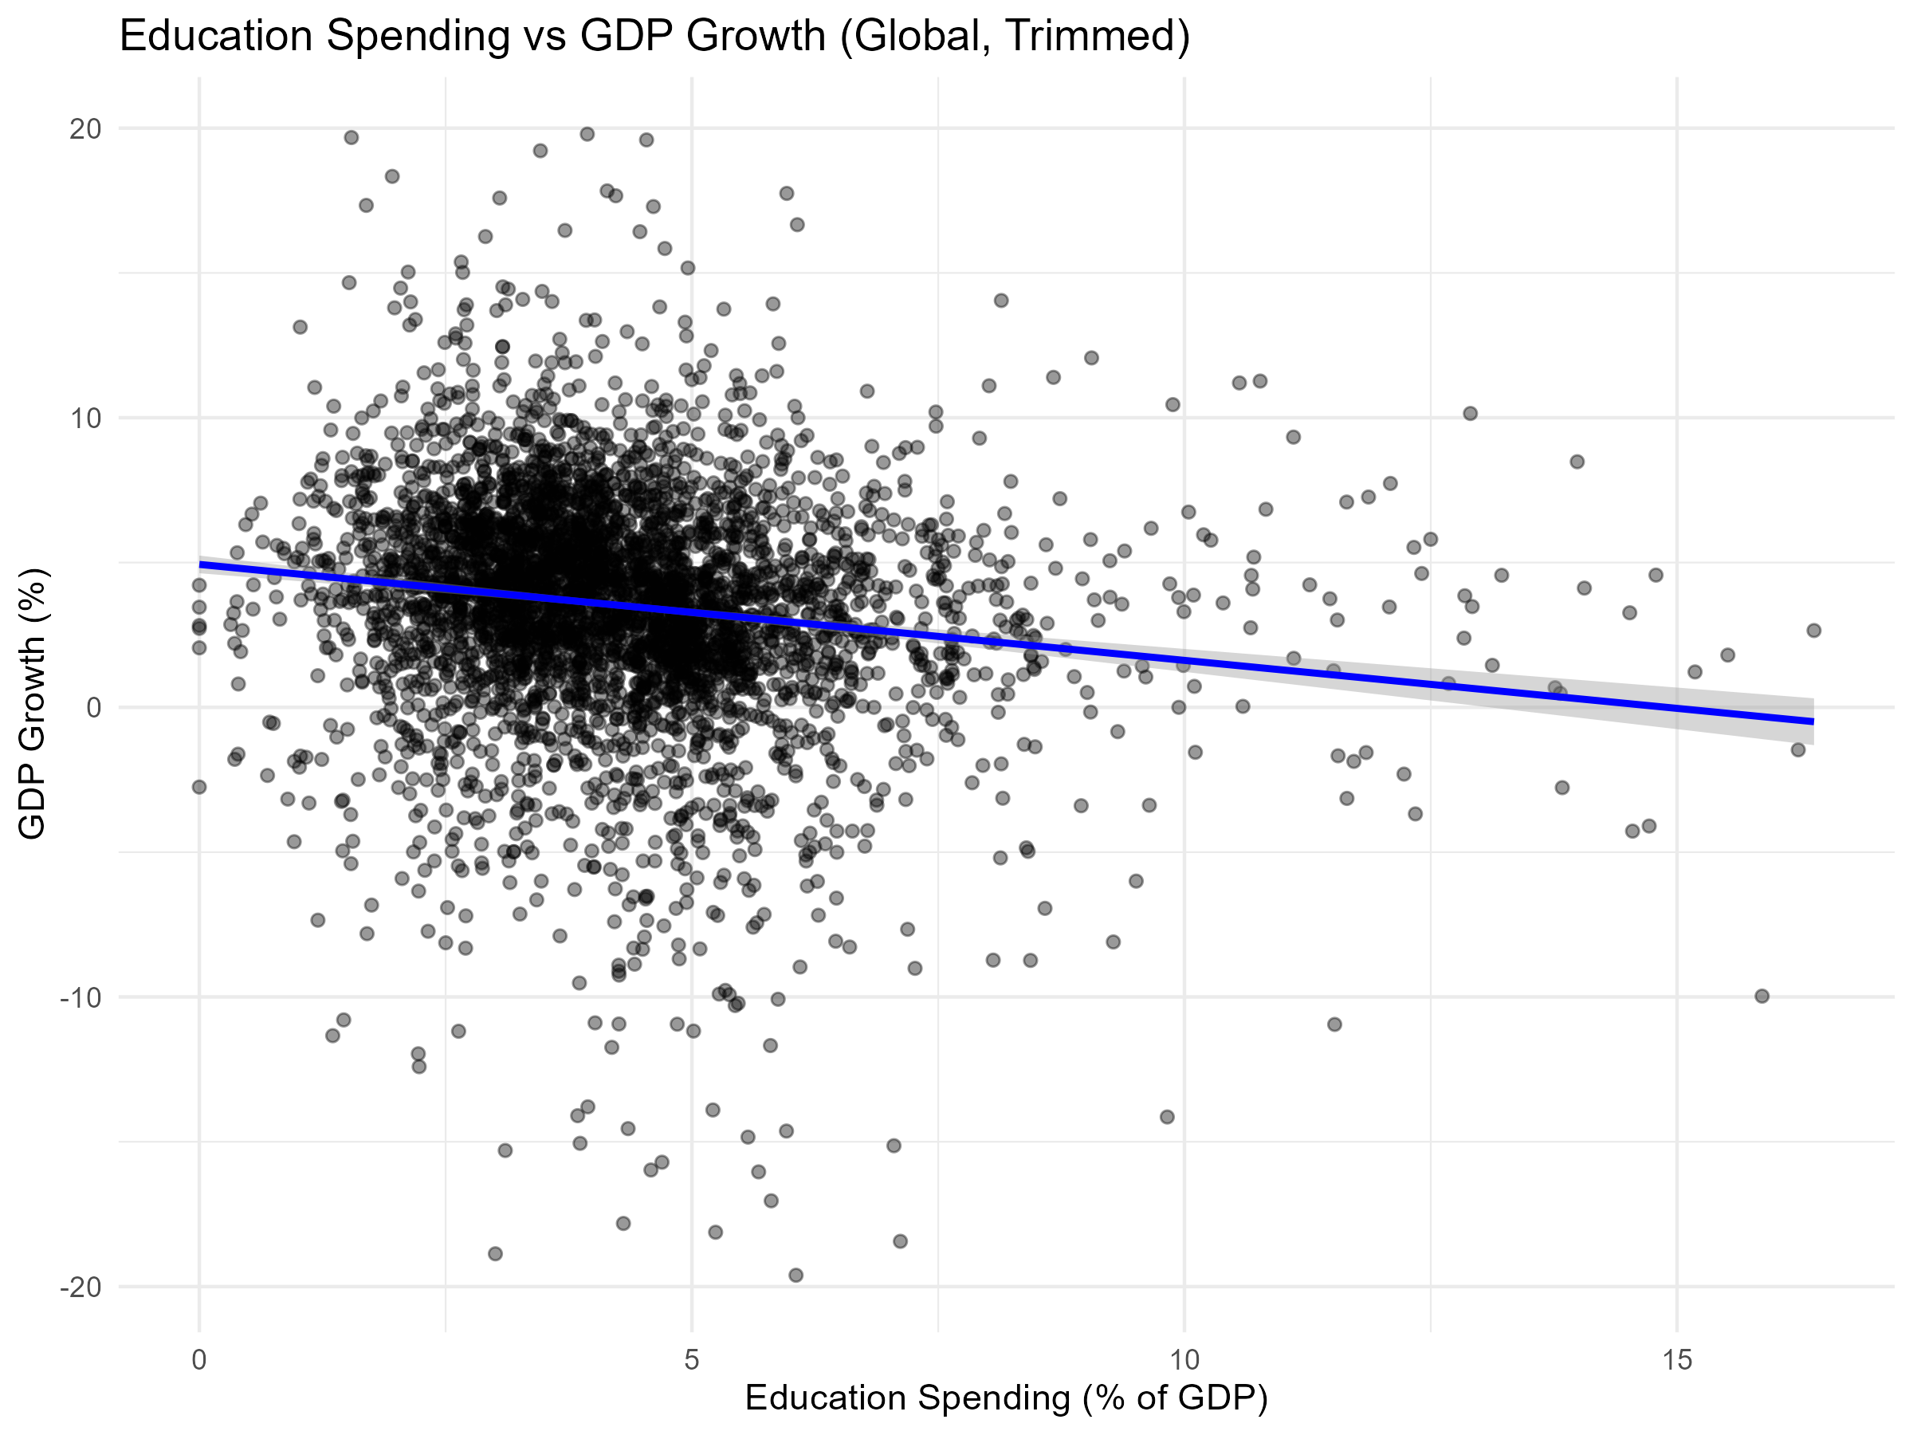
Part 3.2: Exploratory Analysis: Global Relationship

Slide 10
Part 3.2: Exploratory Analysis: Global Relationship
What the plot shows:
Each point = country-year
Large dispersion in GDP growth
Weak visible relationship, even after trimming outliers
Why trimming was used:
Improves visualization
Does not affect modeling results

Slide 11
Part 4.1: Modeling the Relationship
Why build models if not predicting?:
Quantifies how much variation is explained
Tests linear vs non-linear relationships
Confirms EDA findings statistically
Models used:
Linear Regression (baseline)
Random Forest (flexible, non-linear)

Slide 12
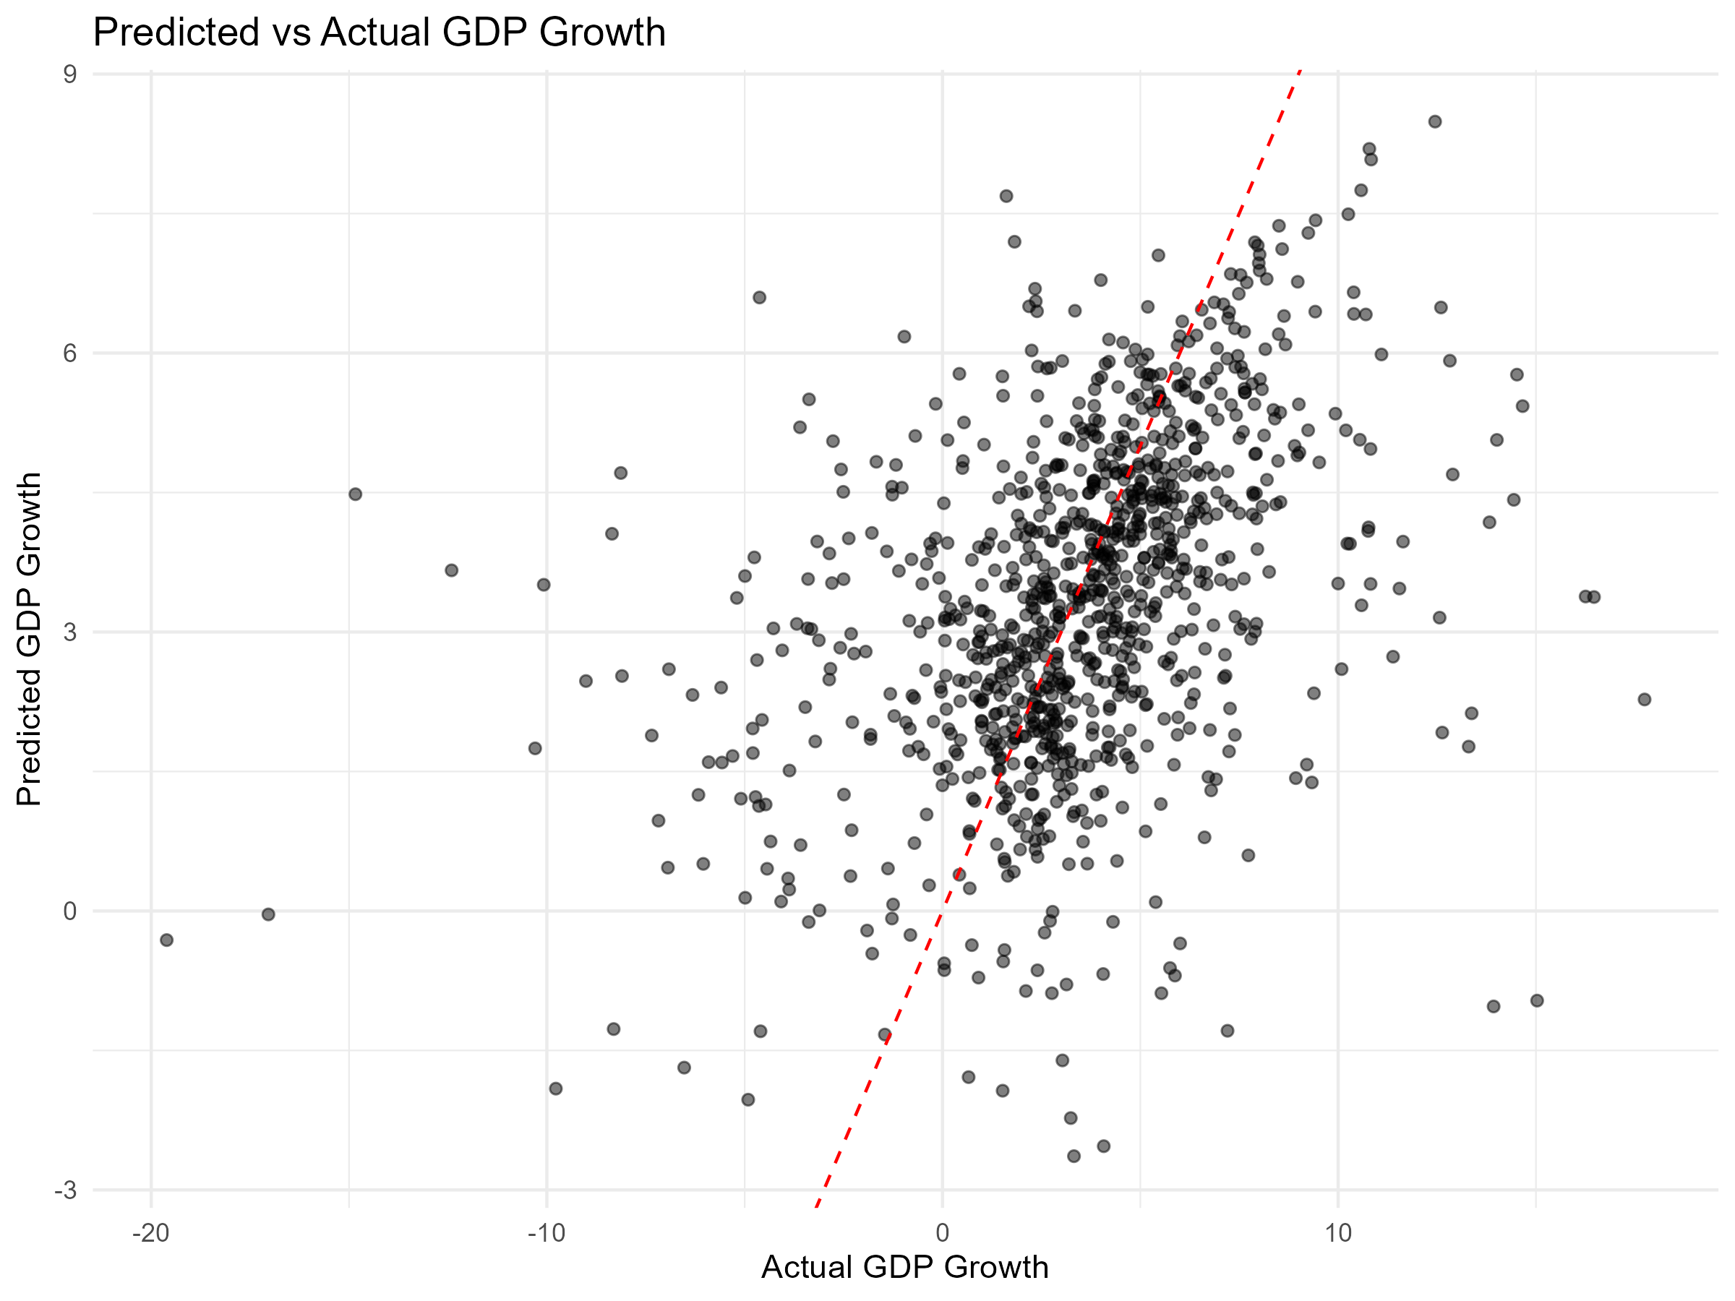
Part 4.2: Model Results

Slide 13
Part 4.2: Model Results
What the plot shows:
Model captures general trends
Large dispersion around the 45° line
Evaluation Metrics:
R² ≈ 0.17
RMSE ≈ 3.54
Interpretation:
Only a small share of GDP growth is explained

Slide 14
Part 4.3: Why Is R² Low?
Key Reasons:
GDP growth affected by:
  Wars
  Pandemics
  Political instability
  External shocks
Many influential factors are unobserved
Important Point:
Low R² reflects economic complexity, not model failure

Slide 15
Part 5: Conclusion
Main Takeaways:
Education spending has a weak short-term association with GDP growth
Modeling confirms EDA rather than contradicting it
Results are associative, not causal
Final Message:
Education matters structurally
Growth is driven by many interacting factors

Slide 16

Education Spending & Economic Growth
A Global Relationship Analysis
World Bank Data • R • Regression & ML
Thank You
Questions?

